Slide 1
Introduction to SMART on FHIR
Deploying a SMART on FHIR Application
Create a deployment environment in AWS
Deploy a SMART on FHIR application
Manage published application availability
Notes:
Welcome to our introduction to SMART on FHIR Application Architecture

Slide 2
Most of the Concepts We Will Discuss Are Trademarked
Notes:
Many of the concepts included in this presentation are trademarked including those shown here.

Slide 3
Most of the Information Provided Here Comes from Other Sources (including the following)
References:
Mandel, Josh, SMART on FHIR (from DevDays, Richmond, 2019) available at https://www.youtube.com/watch?v=N0PXAxBA-J8&t=112s
Cannon, Renee, SMART on FHIR: The Basics, available at https://www.youtube.com/watch?v=MMfe181tmwU
The Cerner SMART on FHIR Tutorial, available at https://engineering.cerner.com/smart-on-fhir-tutorial/
Notes:
Most of the information in this presentation comes from other sources including those shown here.

Slide 4
Introduction
In this activity we will go from Zero* to a fully provisioned AWS EC2 Windows Server running Wildfly and a deployed, published and publicly available instance of a SMART on FHIR application
*We do assume you have an active AWS account you can access

Slide 5
Introduction
This presentation describes in detail how to publish a SMART on FHIR application and make it publicly available
This activity can be generalized to the deployment and publishing of any web application
We use Amazon Web Services as our host for this example
This activity assumes the participant has an existing AWS account where they will be able to create an EC2 instance to host a SMART on FHIR application
We use a Java web application as our SMART on FHIR application for this example
We use JBoss Wildfly as our application
After this activity the participants should be able to
Create an AWS EC2 instance to host a SMART on FHIR application
Deploy a SMART on FHIR application to that environment
Manage the availability of that application (e.g. make the application publicly available or limit access to a specified set of clients)
Test and confirm the availability of our newly deployed application

Slide 6
Part 1: Create an AWS ECW Instance to host our SMART on FHIR application
In this section we will describe how to create an AWS EC2 instance to host our SMART on FHIR Application

Slide 7
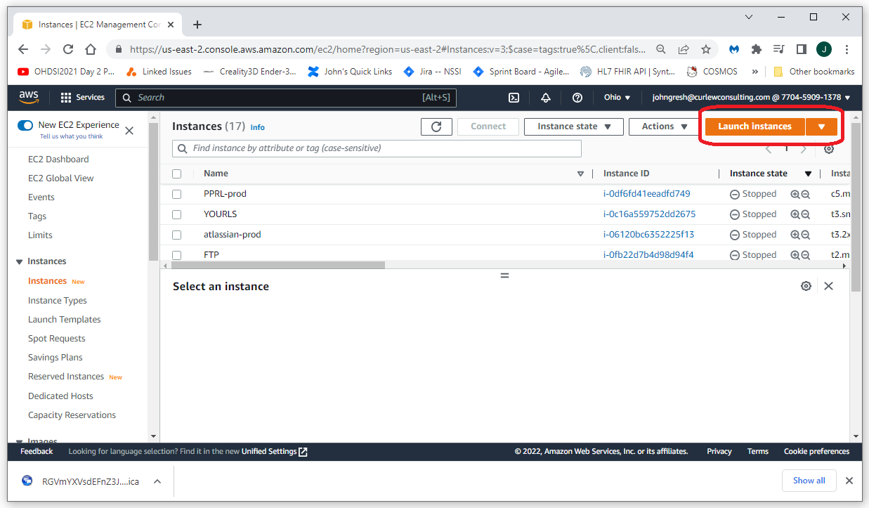
Create an AWS EC2 Instance
Notes:
Log into your AWS account and navigate to EC2
Select Launch Instances, then select Launch Instances from the drop down

Slide 8
Configure the New EC2 Instance
Give your instance a name
Select the Machine
For this example we are using Windows Server 2022 Base
Select the Type
For this example we are using t3.large
Create a key pair
This will be used to generate your admin password
This will download a key file, be sure to save it in a safe place
Limit RDP access
I’m only allowing RDP access from my localhost
When you’re done, Launch
Notes:
Configure your new machine
For this example, we are accepting the defaults for everything except for what is shown here
Give the machine a meaningful name
Select the machine and machine type
Here we are using Windows 2022 Base and t3.large
Create a key pair and be sure to save that is downloaded when the key pair is created
Limit the RDP access
It is very much not a good idea to enable RDP access to anyone on the world wide web

Slide 9
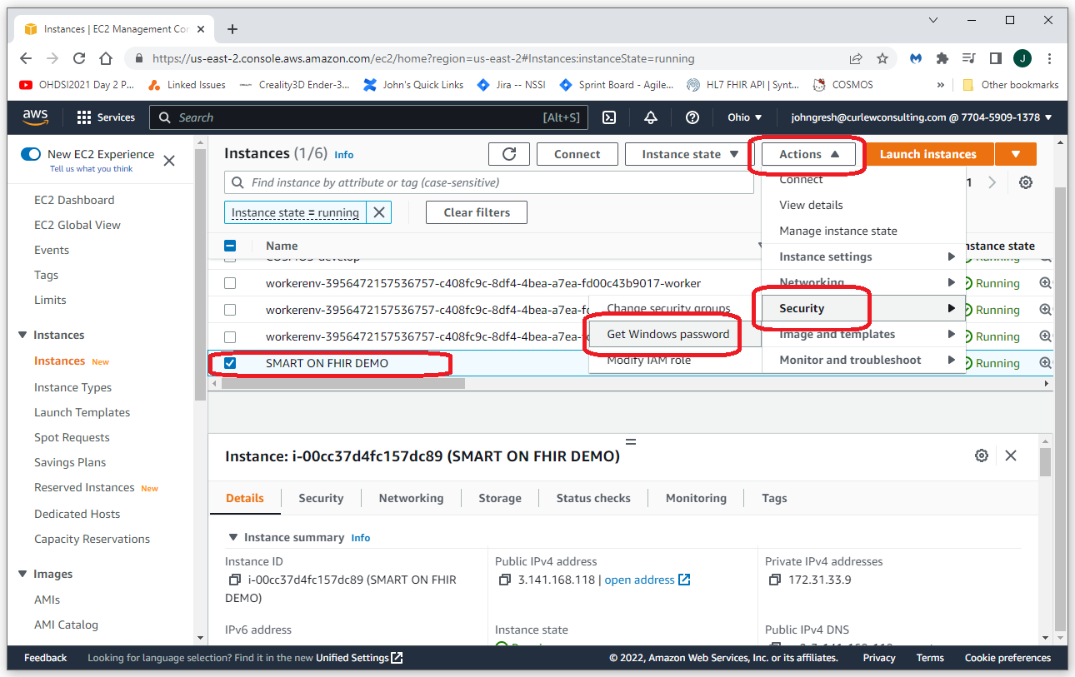
Get the Windows Password: Screen 1 of 2
Notes:
To get the Administrator password
Navigate back to the EC2 page
Select your new instance
Select Action, Security, Get Windows Password

Slide 10
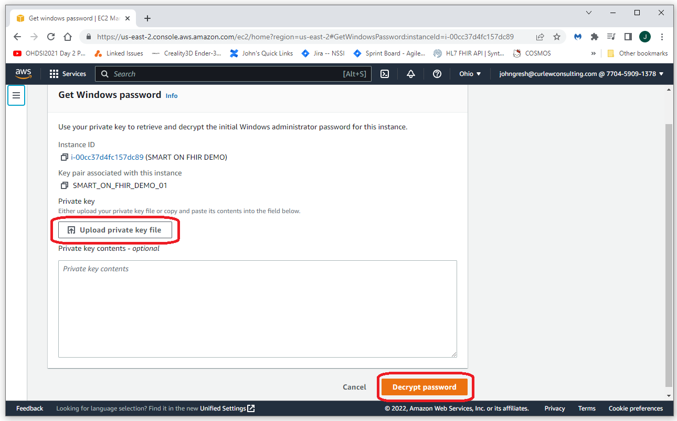
Get the Windows Password: Screen 2 of 2
Notes:
Upload the key file that was downloaded when you created the instance
Select Decrypt Password
Copy and save the password that is generated

Slide 11
Part 2: Provision your new EC2 host
In this section we will describe how to provision your new EC2 server to host a SMART on FHIR application
We will be using an install package called _YES (Yaorma Eclipse Setup)
_YES is a NSIS Windows Installer
This package provides an install for a complete Eclipse development environment and encapsulates all of the tools used for this including a Git client, Maven, Java, Eclipse, Wildfly, etc. The installer will also set environment variables to enable use of these tools at the command line (e.g. JAVA_HOME and Path environment variables)
Documentation for _YES is available at https://nachc-cad.github.io/fhir-to-omop/pages/navbar/how-tos/developer-how-tos/install-eclipse-yes/InstallEclipseYes.html
The _YES installer can be downloaded from https://drive.google.com/drive/folders/1txmjzHY4B-W0A5VkdF3soBLWNKqoChwS

Slide 12
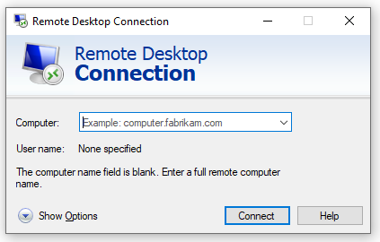
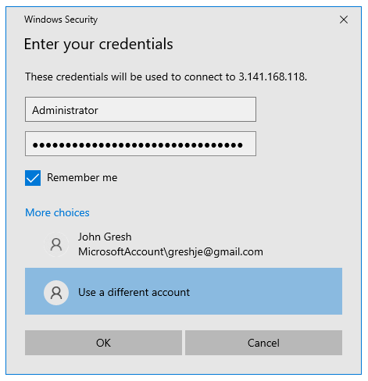
Connect to your new server using RDP
Notes:
You can connect to your new server using RDP
Type RDP in the Windows search and select Remote Desktop Connection
Enter the IP Address (available from the EC2 console) and password (generated from the key as described on previous slides)
I install and use Chrome on my new machines (Chrome will be used as the browser on the server for the following steps)

Slide 13
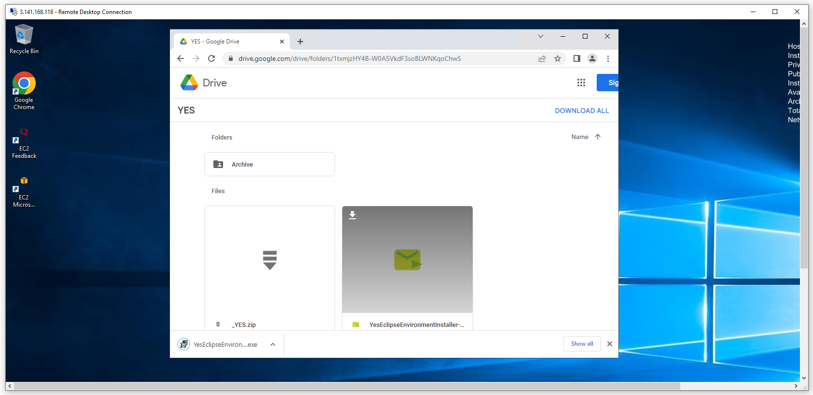
Download _YES
From your new EC2 instance, download the _YES installer by clicking the down arrow shown in the image shown here

Slide 14
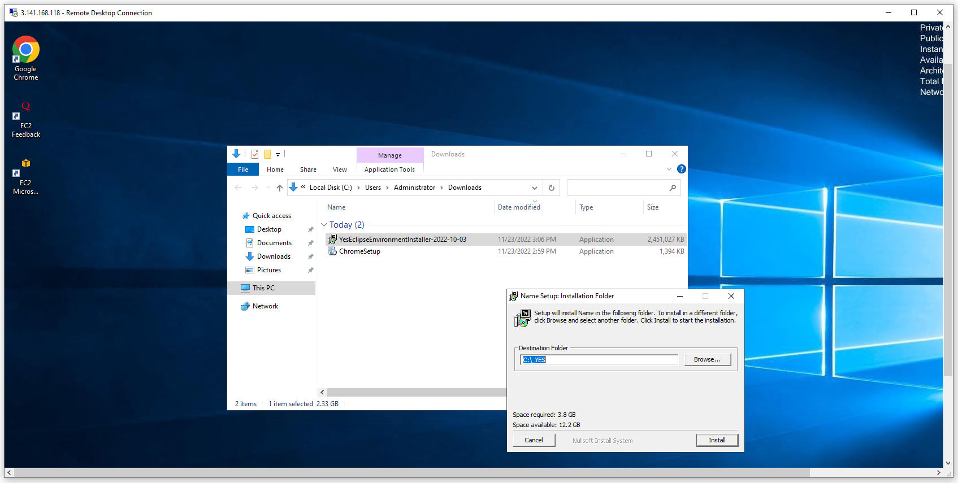
Run the _YES Installer as Administrator
Run the _YES installer by right clicking on the downloaded file and selecting “Run as Administrator”
Accept the default settings and click Install
Notes:
Run the _YES installer as Administrator
Select “More info” then “Run anyway” for the “Windows protected your PC” prompt

Slide 15
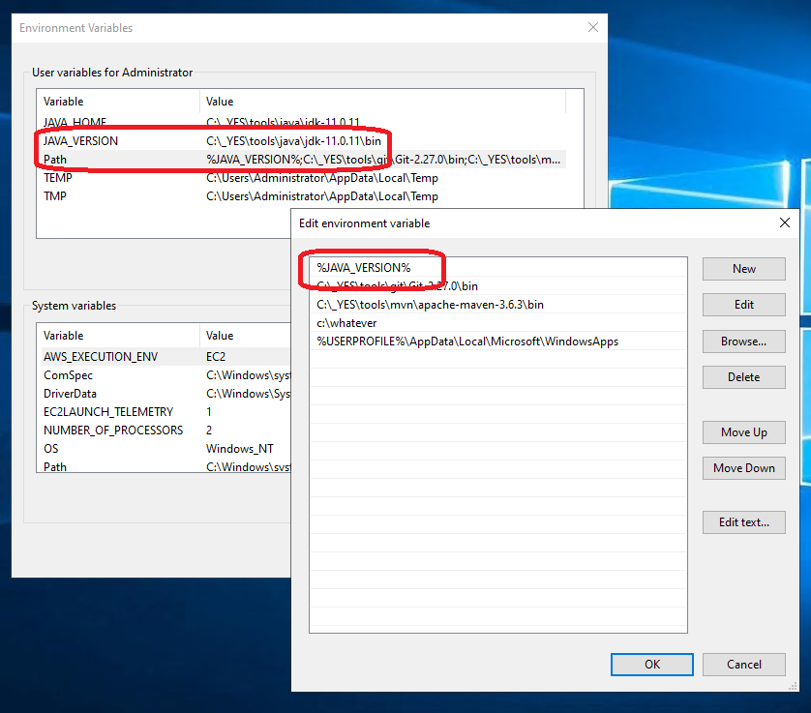
Bug fix ☹
For some unknown reason, the JAVA_VERSION environment variable is not resolved in the Path environment variable on some EC2 Windows servers.
You’ll need to go in and replace the %JAVA_VERSION% entry in the path with the actual value in the %JAVA_VERSION% environment variable
C:\_YES\tools\java\jdk-11.0.11\bin

Slide 16
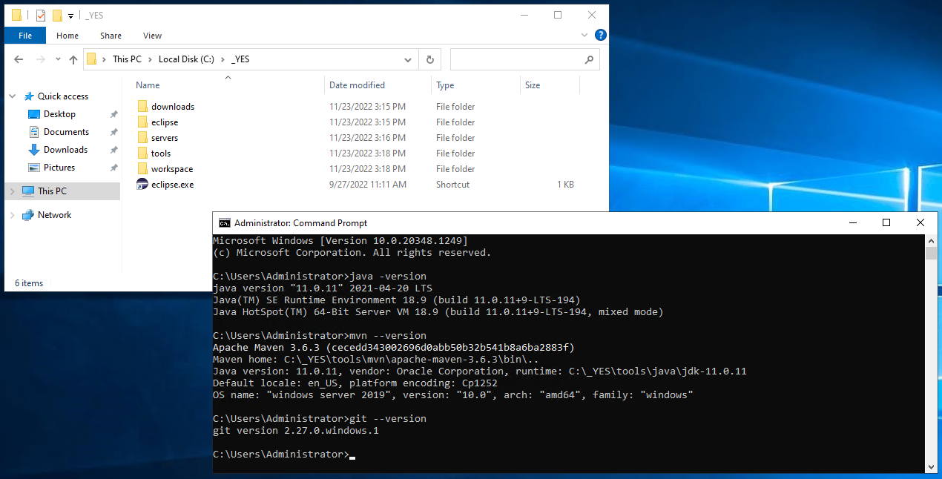
Confirmation of environment
We should now have all of the tools we need including a Git client, Maven (MVN), Java 11, and Wildfly
We can confirm the Java, MVN, and git installs in a new cmd window as shown above

Slide 17
Part 3: Deploy our SMART on FHIR Application to Wildfly
In this section we will go through all of the steps to download, deploy, and run our SMART on FHIR application on Wildfly including the following
Download a published SMART on FHIR web application (our smart-on-fhir-examples application from previous exercises)
Create an Admin User for Wildfly
Deploy our SMART on FHIR application to our Wildfly instance
Confirm that the SMART on FHIR application is up and running and can be accessed from localhost

Slide 18
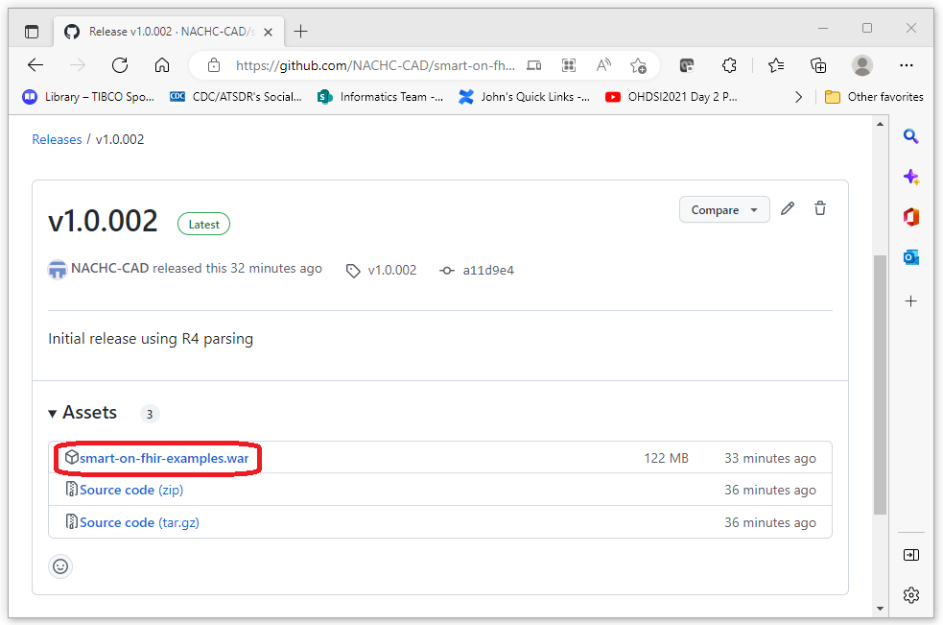
Download an existing SMART on FHIR Application
For this exercise we will be using the smart-on-fhir-examples project
A war file for this application can be downloaded from the url below
Release v1.0.002 · NACHC-CAD/smart-on-fhir-examples (github.com)
Notes:
Download the smart-on-fhir-examples war file from the url shown here
This is the war file we will deploy to our Wildfly server

Slide 19
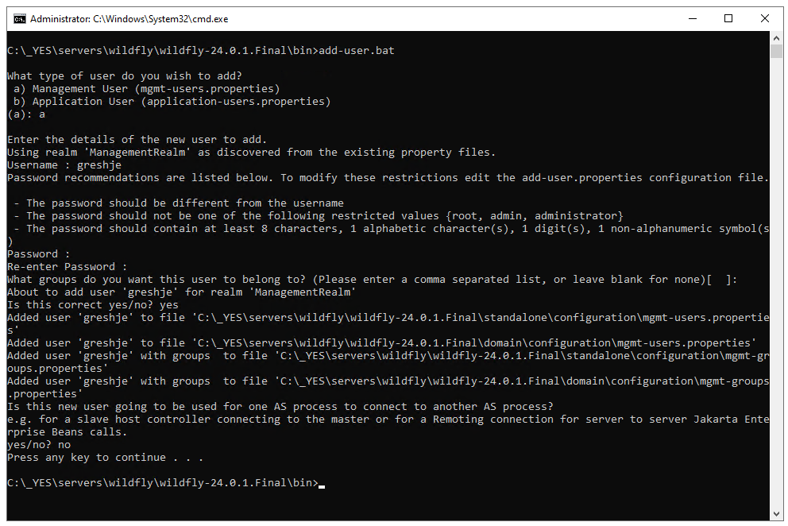
Create an Admin User for Wildfly on Your New Server
Navigate to: C:\_YES\servers\wildfly\wildfly-26.1.1.Final\bin in a cmd prompt
Run add-user.bat
User type is “a”
Enter a username
Enter and re-enter a password
Groups can remain blank
No need to connect to another AS process
Notes:
Navigate to: C:\_YES\servers\wildfly\wildfly-26.1.1.Final\bin in a cmd prompt and
Create an admin user as shown in this slide

Slide 20
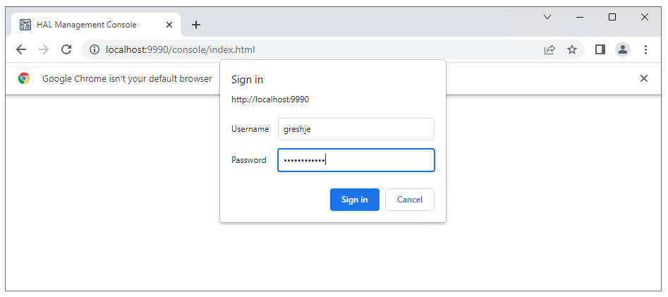
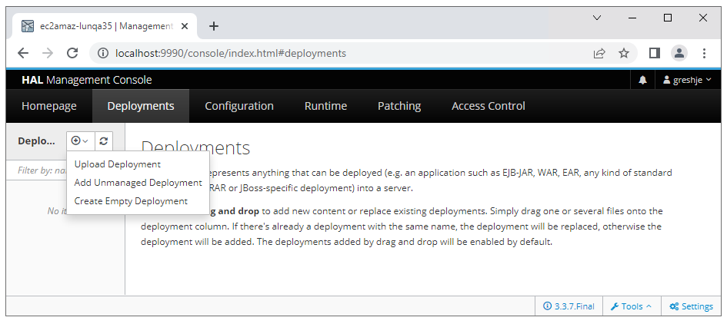
Log into the Wildfly Admin Console Using our New UID/PWD
Log into the Admin Console
Use the UID/PWD we just created
Navigate to Deployments
Select Deployments
Select the (+) icon
Select Upload Deployment
URL for Admin Console: http://localhost:9990

Slide 21
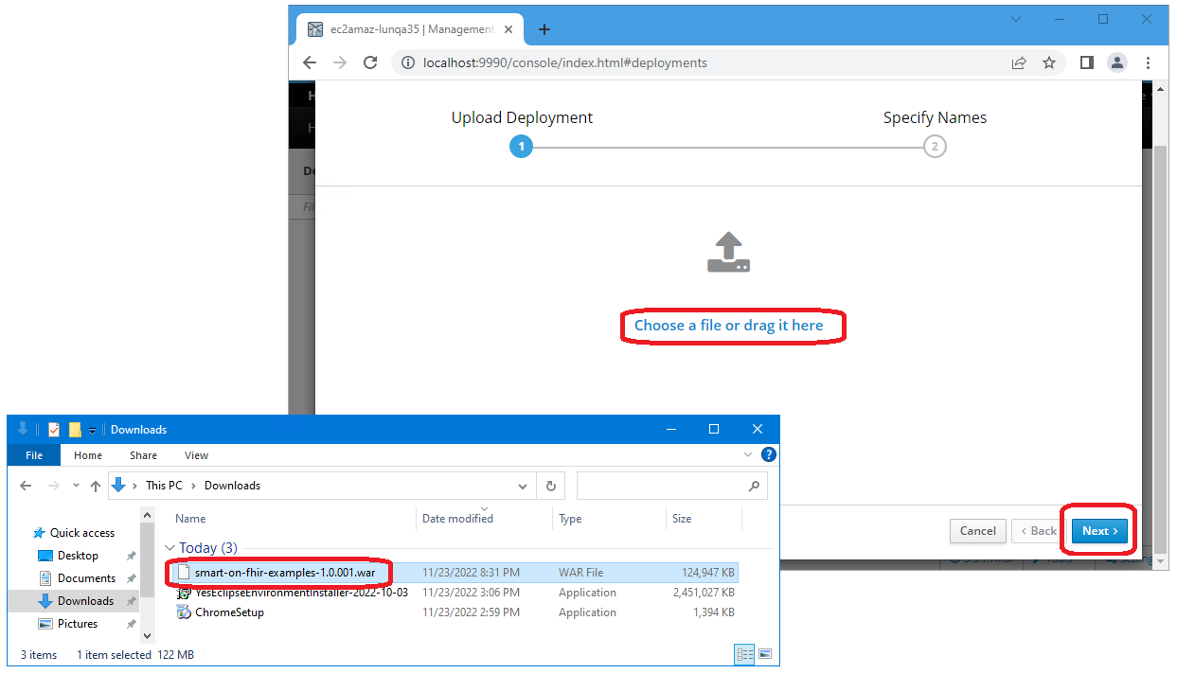
Deploy the smart-on-fhir war file
Drag the smart-on-fhir-examples war file to upload then select next

Slide 22
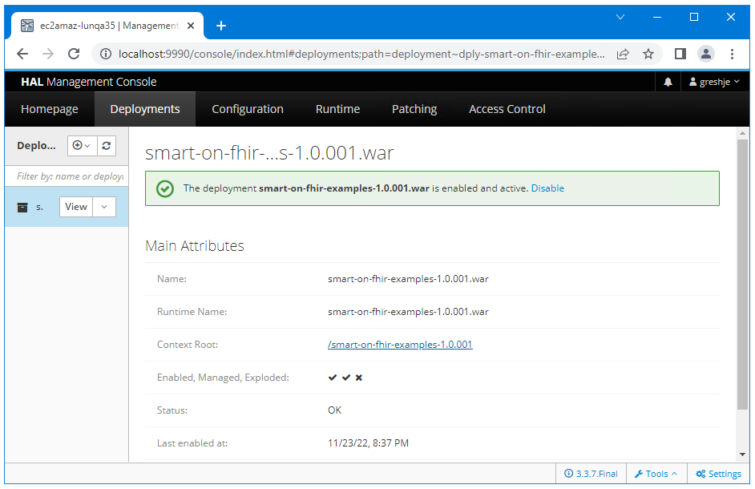
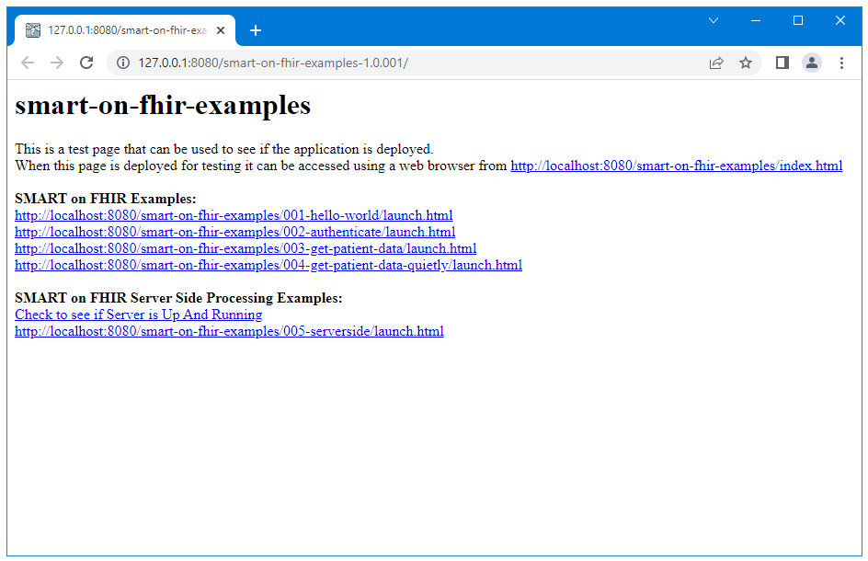
Confirm the Deployment was successful
Click on the “Context Root” link to confirm the application has been deployed
The page on the right should be displayed after clicking the “Context Root” link
The page on the right should also be seen for http://localhost:8080/smart-on-fhir-examples/

Slide 23
Part 4: Publish our SMART on FHIR Application
Our SMART on FHIR Application has now been deployed and is live, but it is still not visible outside of our localhost instance. In this section we will go through the steps to make our SMART on FHIR application visible to the www
Update Wildfly configuration to allow access from remote requests
Update Windows Firewall on the server to allow incoming traffic on port 8080
Update the AWS security group to allow incoming traffic on port 8080
Confirm we can access the appliction

Slide 24
Publish our Application: Configure Wildfly to Allow External Connections
<interfaces>
<!-- REPLACE THIS -->
<!--
<interface name="management">
<inet-address value="${jboss.bind.address.management:127.0.0.1}"/>
</interface>
<interface name="public">
<inet-address value="${jboss.bind.address:127.0.0.1}"/>
</interface>
-->
<!-- USE THIS -->
<interface name="management">
<inet-address value="${jboss.bind.address.management:0.0.0.0}" />
</interface>
<interface name="public">
<inet-address value="${jboss.bind.address:0.0.0.0}" />
</interface>
<interface name="unsecure">
<inet-address value="${jboss.bind.address.unsecure:0.0.0.0}" />
</interface>
</interfaces>
By default, Wildfly does not allow external connections
To allow external connections
Open C:\_YES\servers\wildfly\wildfly-24.0.1.Final\standalone\configuration\standalone.xml
Remove or comment out lines in the “REPLACE THIS” section and the add the “USE THIS” section

Slide 25
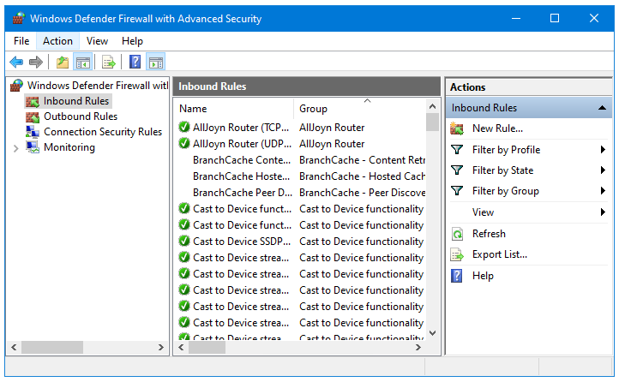
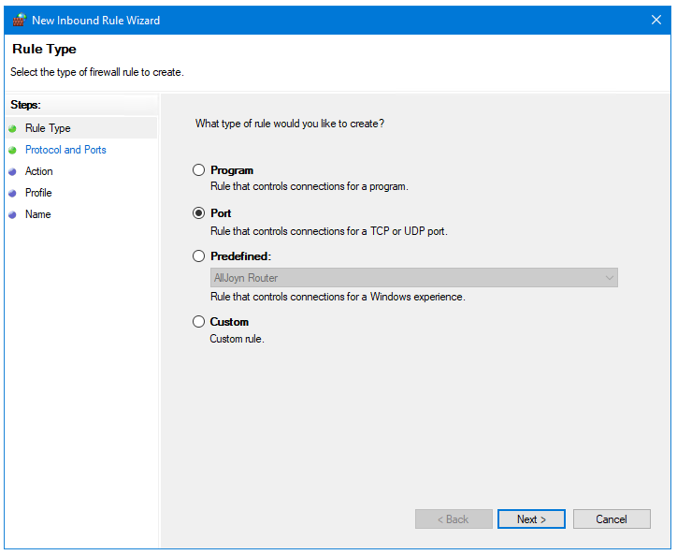
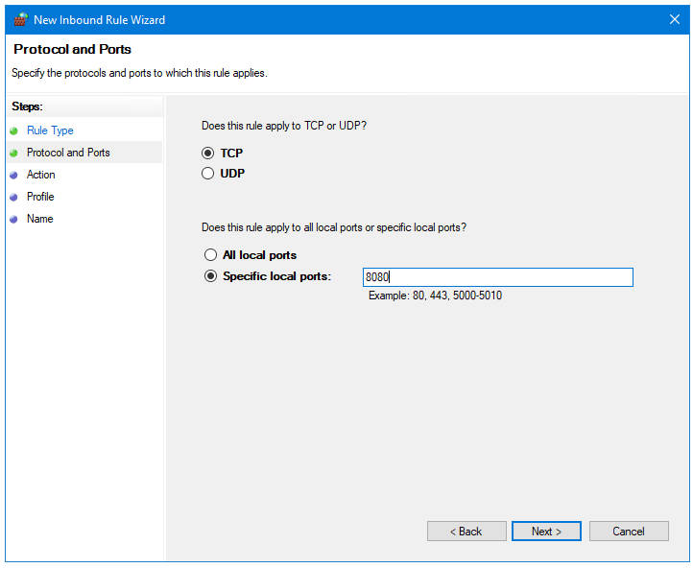
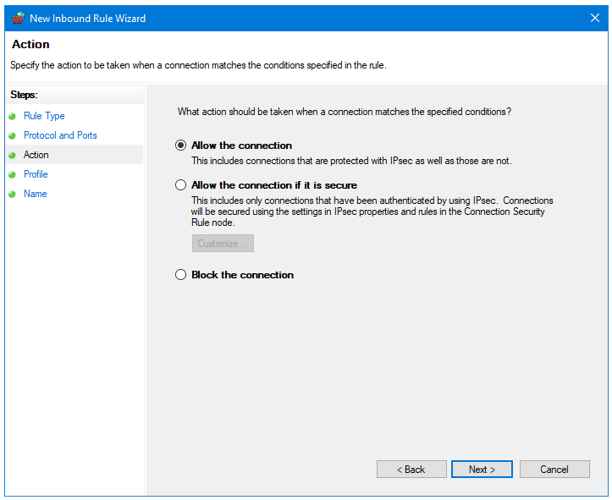
Publish our Application: Open Port 8080 on the Server
Open Windows Defender Firewall and select advanced settings
Select Inbound rules
Select New Rule…
Select Port for the type
Select Allow Connection
Select defaults for other options
Give the rule a meaningful name (e.g. Allow port 8080)
Notes:
Open Windows Defender Firewall and select advanced settings
Select Inbound rules
Select New Rule…
Select Port for the type
Select Allow Connection
Select defaults for other options
Give the rule a meaningful name (e.g. Allow port 8080)

Slide 26
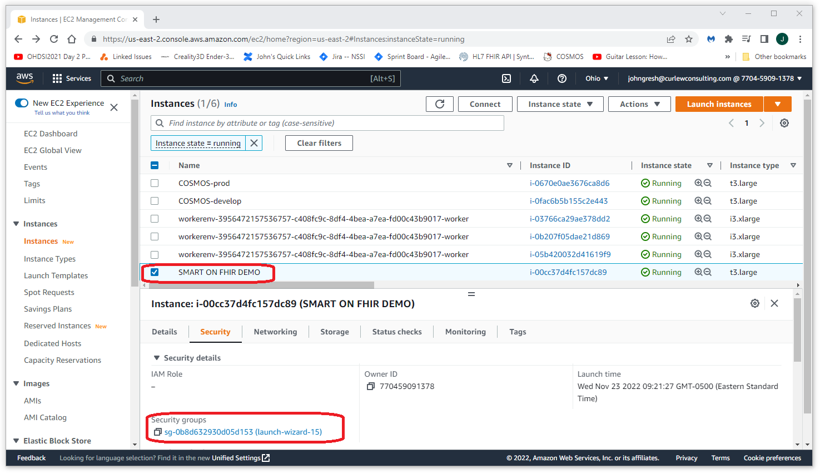
Publish our Application: Open Port 8080 in AWS
Navigate to the Network inbound rules page for the server
Open the AWS console, select EC2, your SMART on FHIR server, and then click on the security group

Slide 27
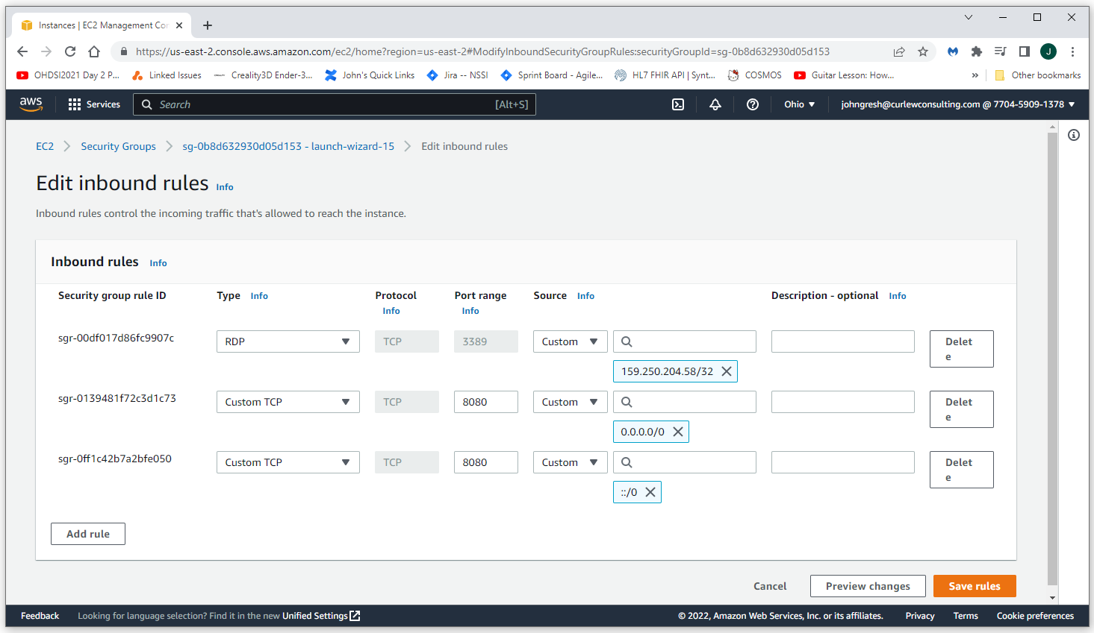
Publish our Application: Open Port 8080 in AWS
Edit the inbound rules
Select Edit Inbound Rules, then select Add Rule. Add the two TCP rules as shown above (one is for Any-IPv4, the other is Any-IPv6) then select Save Rules
Normally, we would restrict access to a limited number of sources, but for this exercise we are making the application publicly available

Slide 28
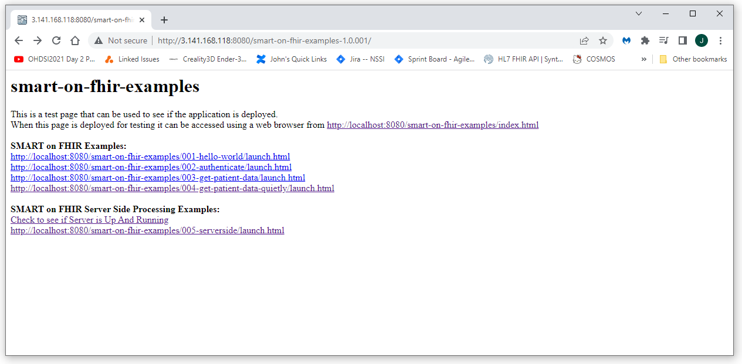
Publish our Application: Confirm the Application is Reachable
Test that the application is reachable by navigating to:
http://<host-ip>/smart-on-fhir-examples
If the server is up and running and is reachable, you should see something like what is shown here

Slide 29
Part 5: Launch our published application from an EMR using SMART on FHIR
Now that our SMART on FHIR application is available publicly we can launch it from any EMR as a SMART on FHIR application
To demonstrate this we will launch our published application from the SmartHealthIt sandbox
But first we will need to make a small adjustment to Chrome to account for our application not being available as https

Slide 30
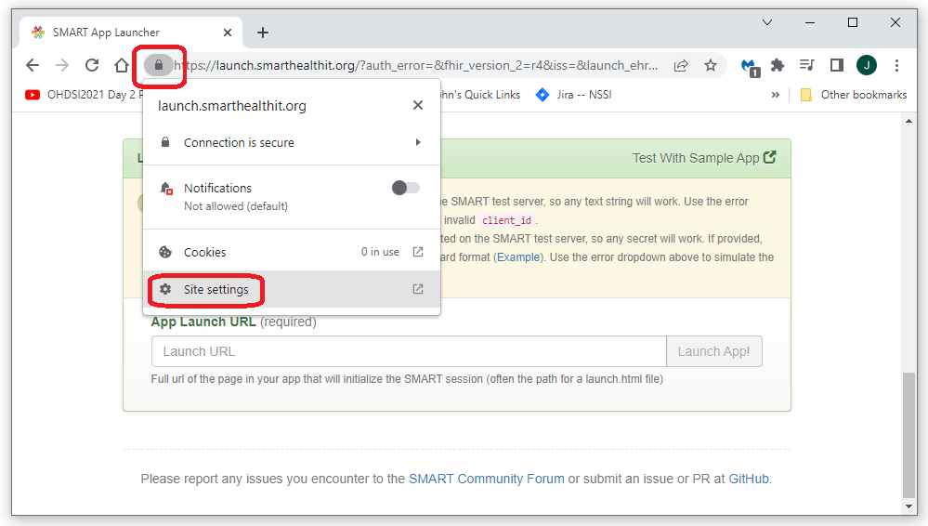
Enable mixed http and https for launch.smarthealthit.org
Open the site settings menu
Since the SmartHealthIt sandbox submits the request to the SMART on FHIR application and our application does not currently support https, we need to tell Chrome that we would like to allow launch.smarthealthit.org to send both https and http content
Do this by opening launch.smarthealthit.org in a Chrome browser, then selecting the lock icon next to the url

Slide 31
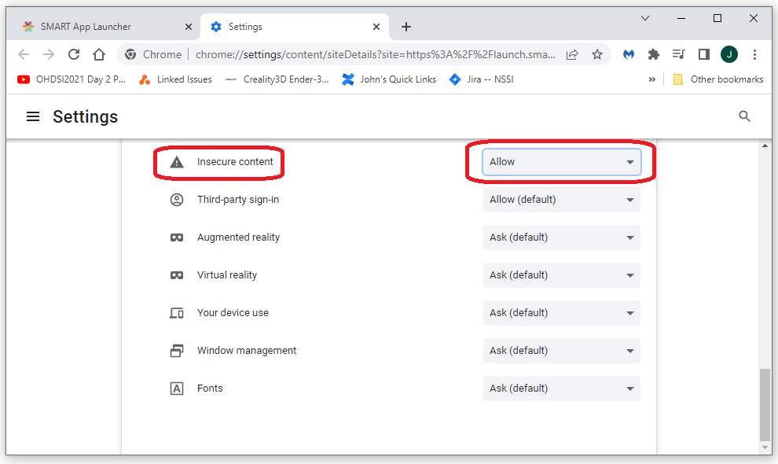
Enable mixed http and https for launch.smarthealthit.org
Open the site settings menu
Scroll down to the Insecure content setting and select Allow
This will allow our http site to be accessed from the https launch executed by the SmartHealthIt sandbox

Slide 32
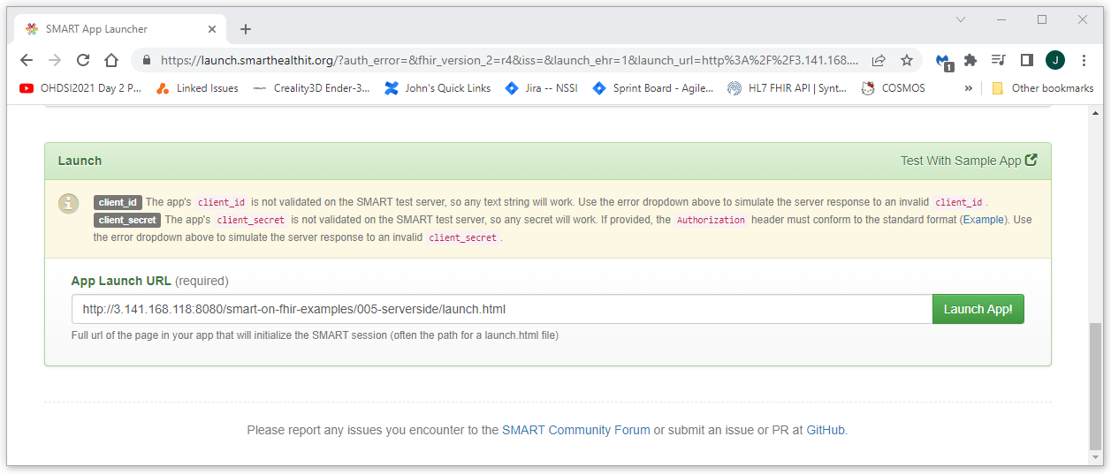
Launch our published SMART on FHIR application from an EMR
Navigate to the SmartHealthIt sand box at https://launch.smarthealthit.org/
Enter the URL for our app and launch: http://<host-ip>/smart-on-fhir-examples/005-serverside
Press the “Launch App!” button

Slide 33
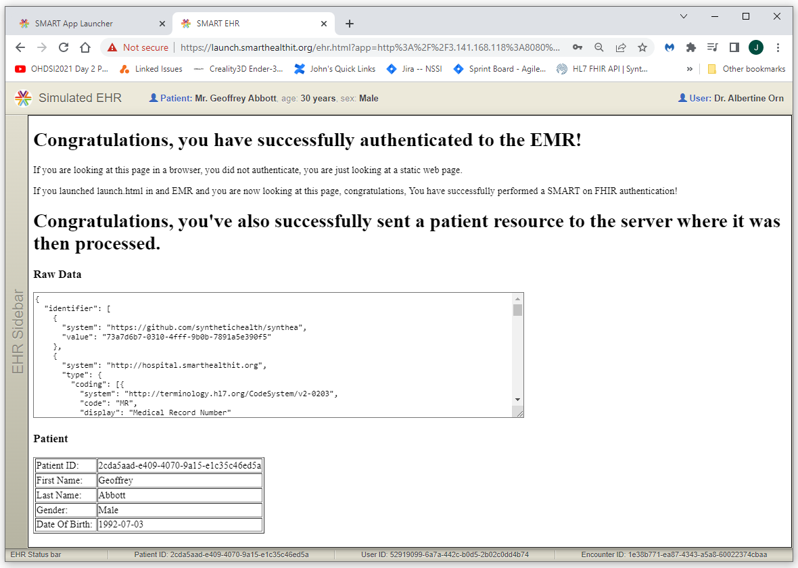
Success!!!
After logging in and selecting a patient, you should get a response from our publicly available SMART on FHIR Application that looks something like this

Slide 34
Summary
This concludes our discussion of the deployment and publishing of a SMART on FHIR application
What we’ve learned
How to create and provision an AWS instance to host our application
How to deploy a SMART on FHIR application to that host
How to manage the availability of our SMART on FHIR application
How to test our SMART on FHIR deployment

