Slide 1
Activity 3: Launch an Implementation of the hiv-cds Questionnaire
For this activity we will use the smart-on-fhir-examples application
We will use the SmartHealthIt Sandbox to launch the application

Slide 2
Most of the Concepts We Will Discuss Are Trademarked
Notes:
Many of the concepts included in this presentation are trademarked including those shown here.

Slide 3
Introduction
The NACHC hiv-cds Project and SMART on FHIR
The smart-on-fhir-examples application URL will be provided during the demonstration (the URL changes as AWS assigns a new IP address every time the server is restarted)
We will use the SmartHealthIt sandbox to simulate an EMR
https://launch.smarthealthit.org/
But first we will need to make a small adjustment to Chrome to account for our application not being available as https

Slide 4
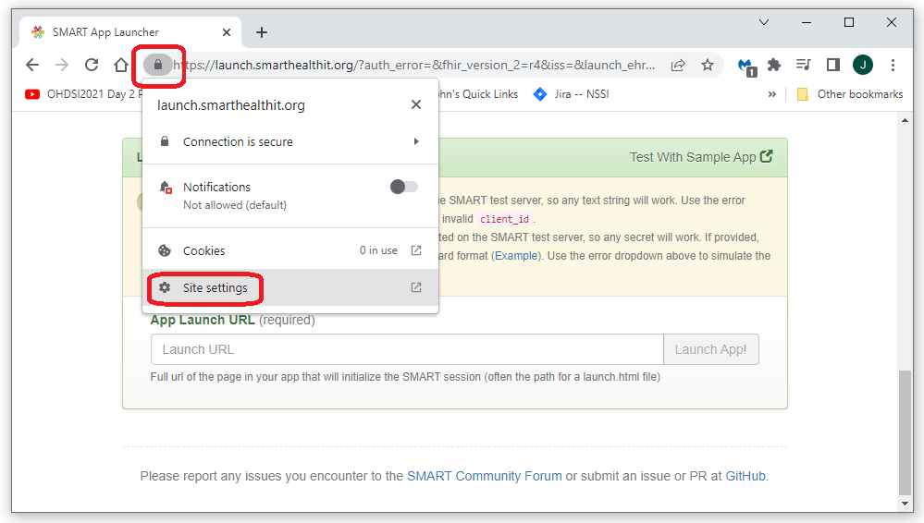
Enable mixed http and https for launch.smarthealthit.org
Open the site settings menu
Since the SmartHealthIt sandbox submits the request to the SMART on FHIR application and our application does not currently support https, we need to tell Chrome that we would like to allow launch.smarthealthit.org to send both https and http content
Do this by opening launch.smarthealthit.org in a Chrome browser, then selecting the lock icon next to the url

Slide 5
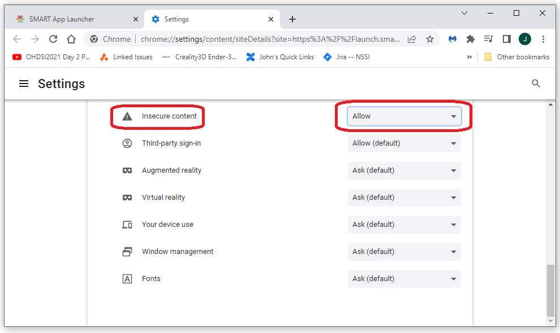
Enable mixed http and https for launch.smarthealthit.org
Open the site settings menu
Scroll down to the Insecure content setting and select Allow
This will allow our http site to be accessed from the https launch executed by the SmartHealthIt sandbox

Slide 6
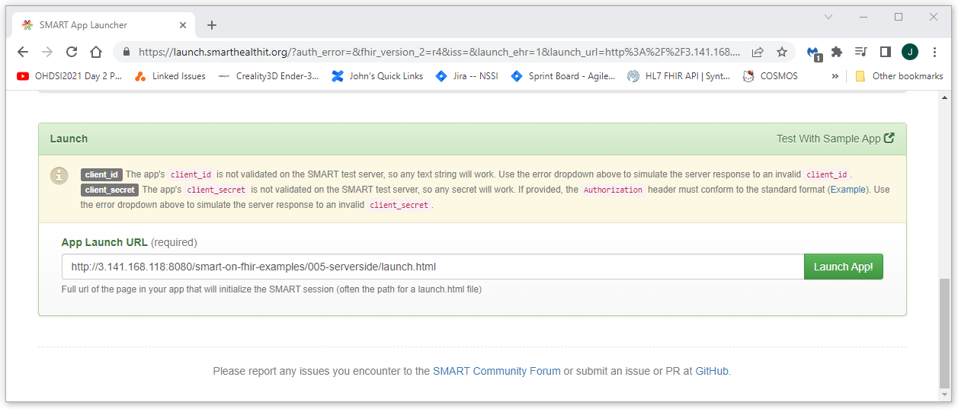
Launch our published SMART on FHIR application from an EMR
Navigate to the SmartHealthIt sand box at https://launch.smarthealthit.org/
Enter the URL for our app and launch: http://<host-ip>/smart-on-fhir-examples/006-lforms/launch.html
Press the “Launch App!” button

Slide 7
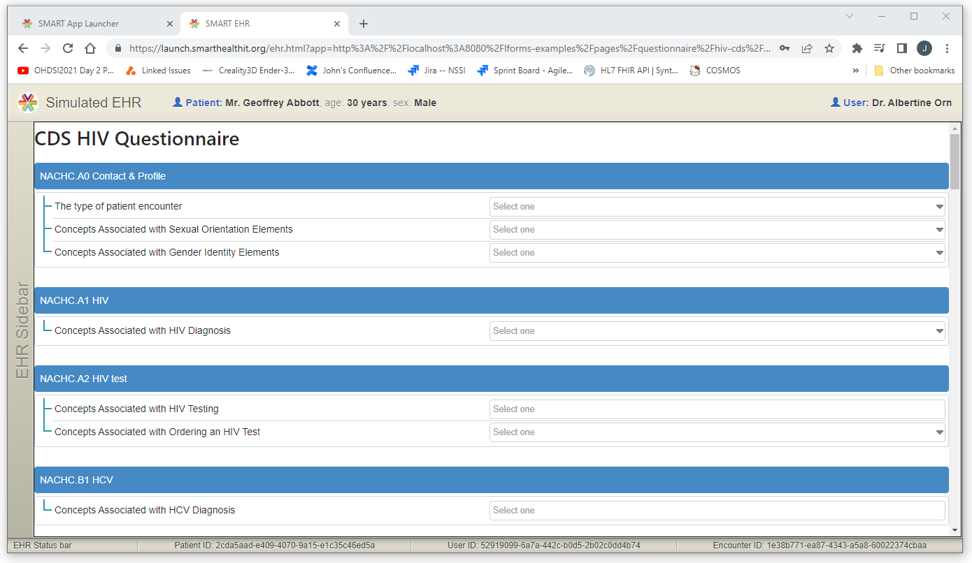
Success!!!
After logging in and selecting a patient, you should get a response from our publicly available SMART on FHIR Application that looks something like this

